Slide 1

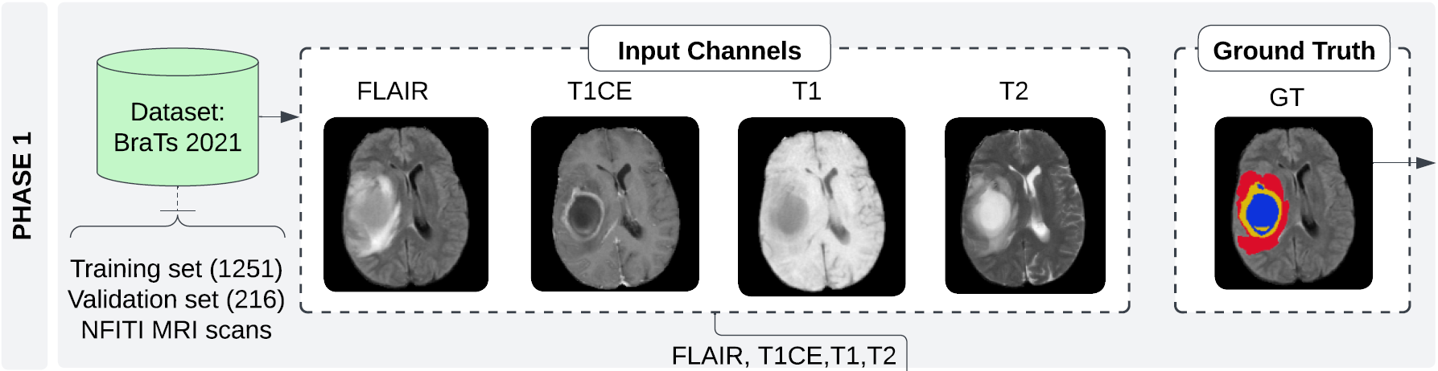
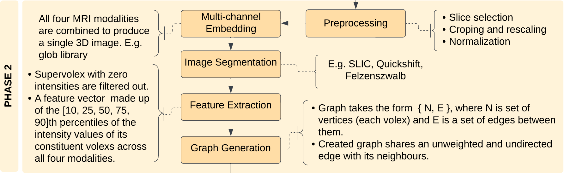
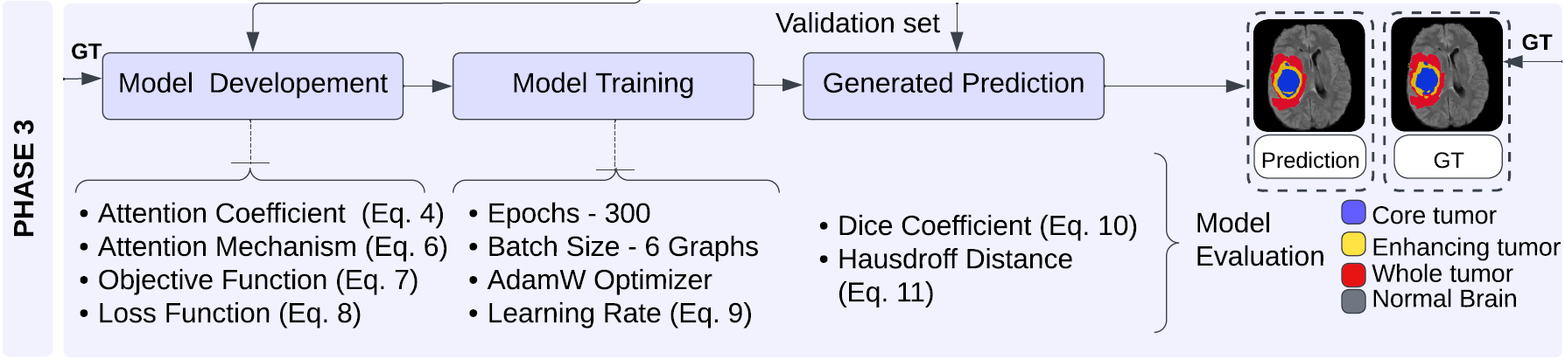
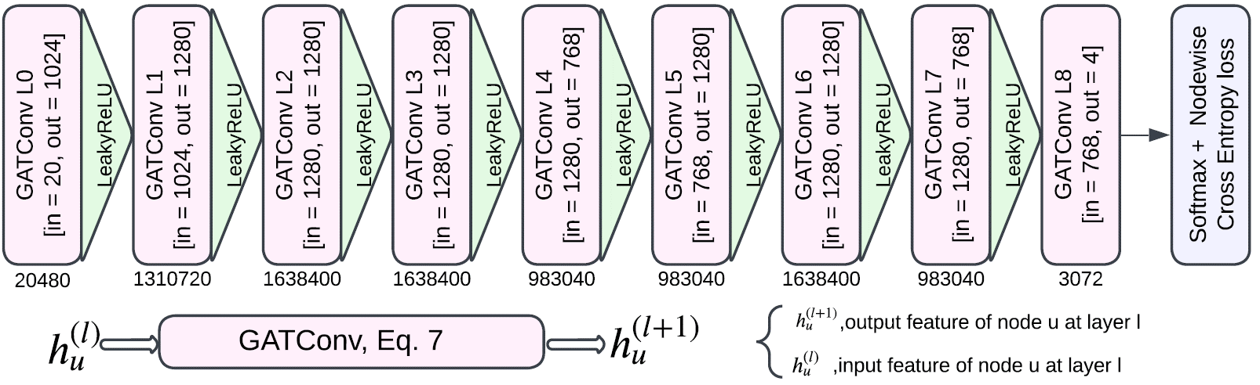
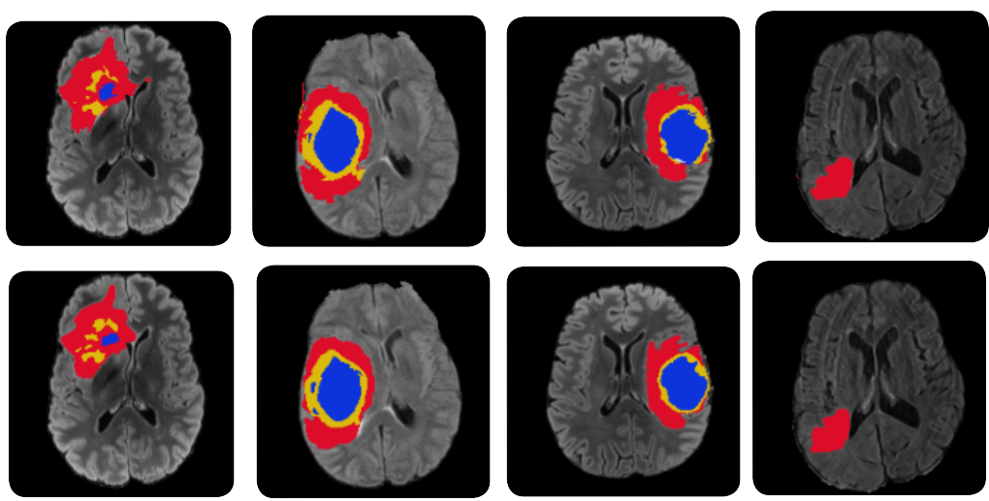
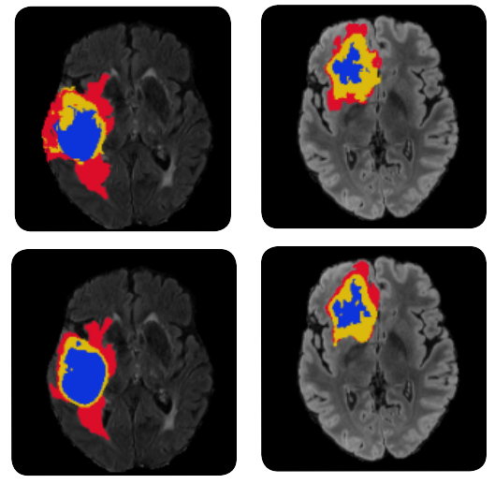
A Graph Attention Network for Automatic Brain Tumor Segmentation
By: Dhruv Patel, Dhrumil Patel, Rudra Sexena, and Jeevan Sai
Supervisor: Dr. T. Akilan (Ph.D.)
Abstract
Proposed Solution
Methodology
A brain tumor: an abnormal growth of tissue, which is found to be unchecked by the normal cell-cycle control mechanism.
Early detection of brain tumors is imperative for enhancing patient care, tailoring treatment strategies, and saving lives.
Manual segmentation requires a high level of expertise and is time-consuming.
This study proposes a graph attention (GAT)-based model by exploiting multichannel (FLAIR, T1CE, T1, and T2) MRI modalities for brain tumor segmentation.
On average, the model performs 6% better than a baseline, on the dice score evaluation metric.
Phase 1: Fusion of multimodality MRI data, including FLAIR, T1CE, T1 and T2.
Phase 2:
2.1. Performed image segmentation of 3D MRI using SLIC and generated feature vector based on the intensity values for each Volex.
2.2. Produced graph in the form of {N, E}, where N is set of vertices and E is a set of edges between them.
Phase 3:
3.1. Training and validation of GAT model using BRATS datasets.
3.2. Evaluation - segmentation results of all type of tumors are evaluated using dice coefficient.
Objectives
Experimental Results
Localizing core, enhancing, and whole tumors preciously.
Introducing a computationally efficient GAT model for unstructured MRI brain tumor segmentation.
Method | Tumor Subregion Dice Score |  |  | Avg. Dice Score | % of Improvement
 | WT | TC | ET
GNN [2] | 0.87 | 0.78 | 0.74 | 0.80 | Baseline
GNN-CNN [2] | 0.89 | 0.81 | 0.73 | 0.81 | 1.5 ↑
3D CMM-net [3] | 0.84 | 0.81 | 0.75 | 0.80 | -
3D-UNet [4] | 0.87 | 0.76 | 0.73 | 0.79 | 1.0 ↓
GAT (ours) | 0.91 | 0.86 | 0.79 | 0.85 | 6.0 ↑
Detailed flow diagram of the proposed solution. It consists of three phases. Phase 1: Data Collection, Phase 2: Data Curation, and Phase 3: Model Development and Evaluation.
Challenges
Layer-wise Schematic of the Proposed GAT
Brain tumors can occur anywhere in the brain and can vary greatly in size, form, and morphology.
MRI scans are distorted and poorly contrasted due to non-uniformity in the static magnetic field and non-linearity in the gradient magnetic field.
Training requires high computational power.
Sample#543 Sample#1619 Sample#777 Sample#241 Sample#176 Sample#0
Prediction Ground Truth
Datasets
Detailed layer-wise schematic of the GAT: It subsumes GATConv layers alternated with a non-linear activation. Every GATConv layer updates each node’s features by sampling neighboring nodes and aggregating the features by concatenation. LeakyReLU is applied with negative input slope α = 0.2 for calculating the. The output of GAT has an associated node-wise multi-label cross-entropy loss. Numbers below each layer represent the trainable parameters for respective layers.
References
BRATS 2021.
Two different sets of data namely Training set (1251 patient's data), and Validation set (216 patient's data).
R. Achanta, A. Shaji, K. Smith, A. Lucchi, P. Fua, and S. S ̈usstrunk, “Slic superpixels compared to state-of-the-art superpixel methods,” IEEE transactions on pattern analysis and machine intelligence, vol. 34, no. 11, pp. 2274–2282, 2012.
C. Saueressig, A. Berkley, R. Munbodh, and R. Singh, “A joint graph and image convolution network for automatic brain tumor segmentation,” in Intl. MICCAI Brainlesion Workshop, pp. 356–365, 2022.
Y. Choi, Al-masni, M.A. and Kim, D.H., 2022, July. 3D CMM-Net with Deeper Encoder for Semantic Segmentation of Brain Tumors in BraTS2021 Challenge. In Brainlesion: Glioma, Multiple Sclerosis, Stroke and Traumatic Brain Injuries: 7th International Workshop, pp. 333-343, 2021.
G. Singh and A. Phophalia, Multimodal Brain Tumor Segmentation Using Modified UNet Architecture, pp. 295–305. 07 2022.
Department of Software Engineering, Lakehead University, 955 Oliver Road, Thunder Bay, Ontario, P7B 5E1, Canada.

